Slide 1
Use of GIS Systems in Official Statistics

Slide 2
Overview of Presentation
Overview of GIS systems
Current use within the ABS
Potential future applications

Slide 3
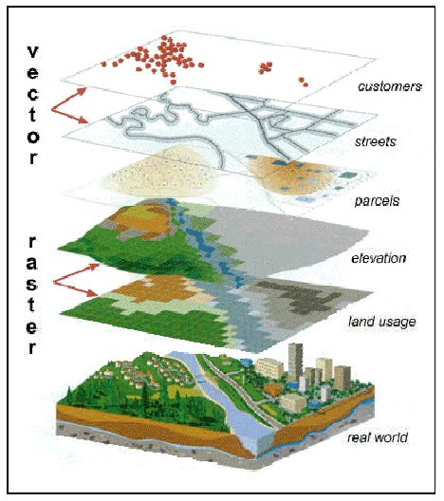
Overview of GIS systems
- GIS systems provide tools to;
Capture and edit geographic information
Manage the information on a "layered" basis
Spatially analyse information
Present information
They have broad application in improving production, analysis and disemmination of statistics

Slide 4
Current Applications of GIS within ABS -
Building the Foundations for GIS
Good quality base data is essential to benefit from GIS
Since the Mid 1990's ABS has utilised GIS, primarily to improve the efficiency of the Census of Population and Housing
ABS was instrumental in the formation of a consortium of Federal, State and Territory mapping agencies to deliver multi resolution base data
Now have an established data supply arrangement with PSMA Australia

Slide 5
Data Priorities
Integrated national datasets required at sufficient levels of detail
Transport and topography
  transport, hydrology, greenspace
Cadastre (property boundaries)
Administrative Boundaries
  State, local government, suburbs & localities
  Electoral boundaries
Geocoded street addresses
Imagery

Slide 6
GIS in the Production of Standard Statistical Geography
CD Review and Redesign
Map Production
Creation of Mesh Blocks

Slide 7
GIS Tools Currently in Use
MapInfo Professional is the main GIS system used
Data is stored in Oracle Spatial
Applications developed in MapBasic programming language to automate functions
Maplex software integrated with MapInfo to automate text placement on CD maps
A3 Laser plotters and HP large format inkjet plotters used for map printing
A dedicated map print room and map handling facility was used for 4.5 months for map production

Slide 8
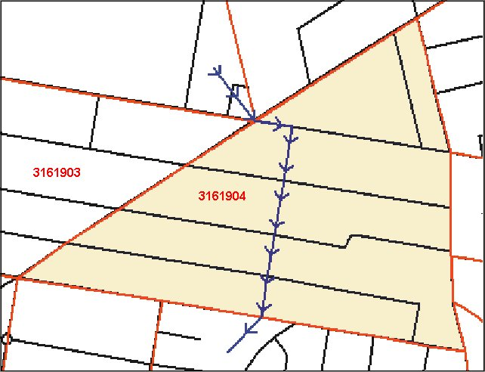
CD Review and Redesign
GIS tools have been developed to improve CD design process to automate the split and amalgamation of CDs
Each state office reviews its 2001 Collection Districts making adjustments for population
change.
37,209 CDs in 2001 has increased to 38,704
CDs for 2006.

Slide 9
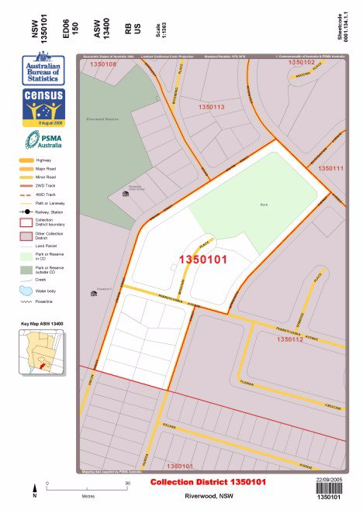
Automated Map Production
For each Collection District 2 copies of a map is produced
Many larger maps included insets for more detail
In total 93,804 maps were produced as follows:
  69,548 A3 maps
  7,840 A2 maps
  3,920 inserts
  5,818 inset maps and;
  6,678 ASW maps.
All maps are stored as PDF files.

Slide 10
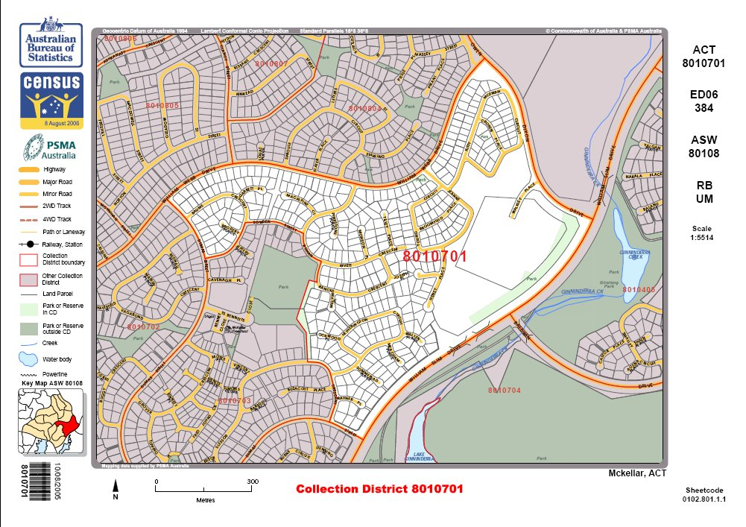
An Urban CD Map
Notes:
Good quality A3 maps
Barcoded - With key map

Slide 11
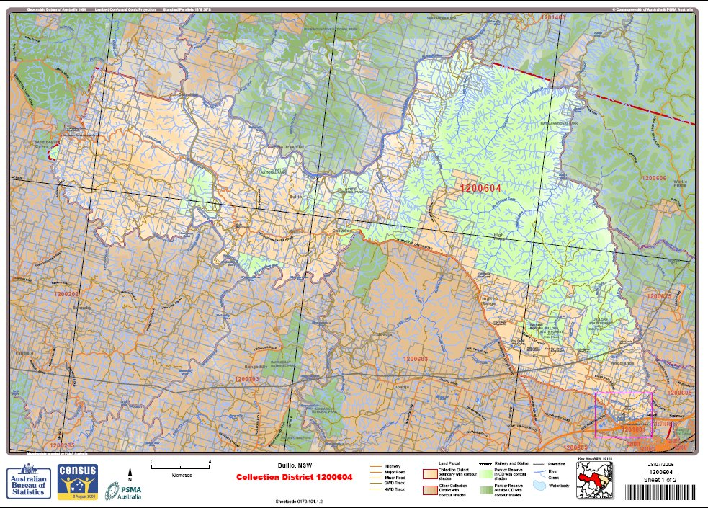
A Rural CD Map
Notes:
Rural CD maps also show some topography to aide collectors - like the hydrology and ipsometric tints to show heights
Use of insets for detail

Slide 12
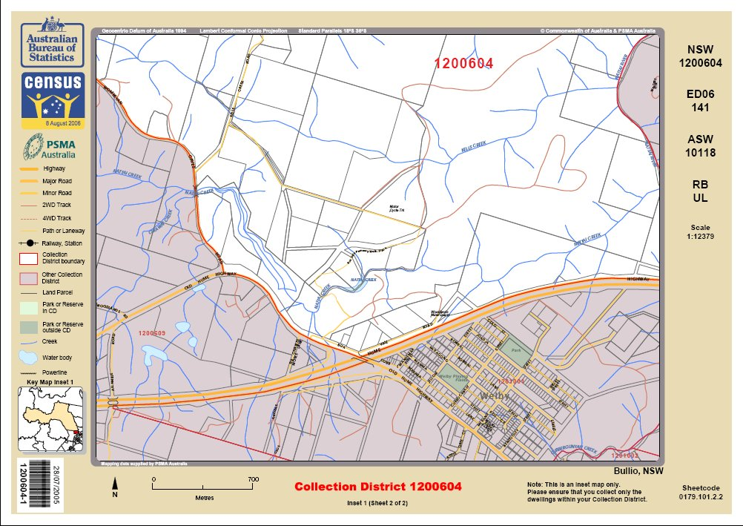
Inset to a Rural CD Map
Notes:
CD 1200604
MB
??
Otherwise known as Bullio NSW

Slide 13
Building a New Output Unit - the Mesh Block
Need for a smaller unit as a building block to integrate statistics based on different units
Stable over time - can track changes
Protect confidentiality
The Mesh Block!
Notes:
So if we can break the link between collection units and output units we can have more relevant criteria applied for output units.
Criterial like these

Slide 14
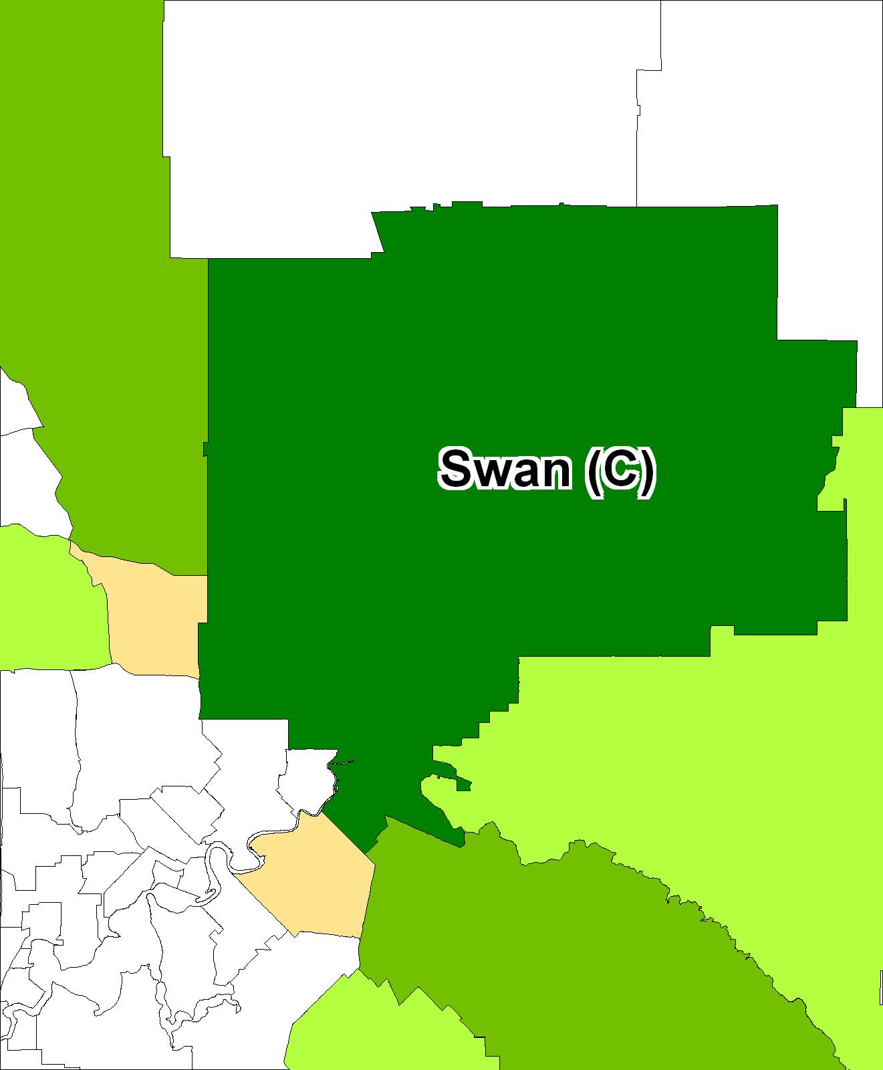
The Benefits of Smaller Units of Geography
Vines (Bearing)
840.9 ha
Total Area of Shire
104,200ha
Vines (Bearing)
0.8%of area of Shire
Grape Bearing Vines in the SLA of Swan (C)
The Statistical Model
Notes:
The statisticians model looks something like this. This is an example of grape growing areas in a SLA of Swan, in the Swan Valley of WA.
Mapping the tabular data results in something like the above map

Slide 15
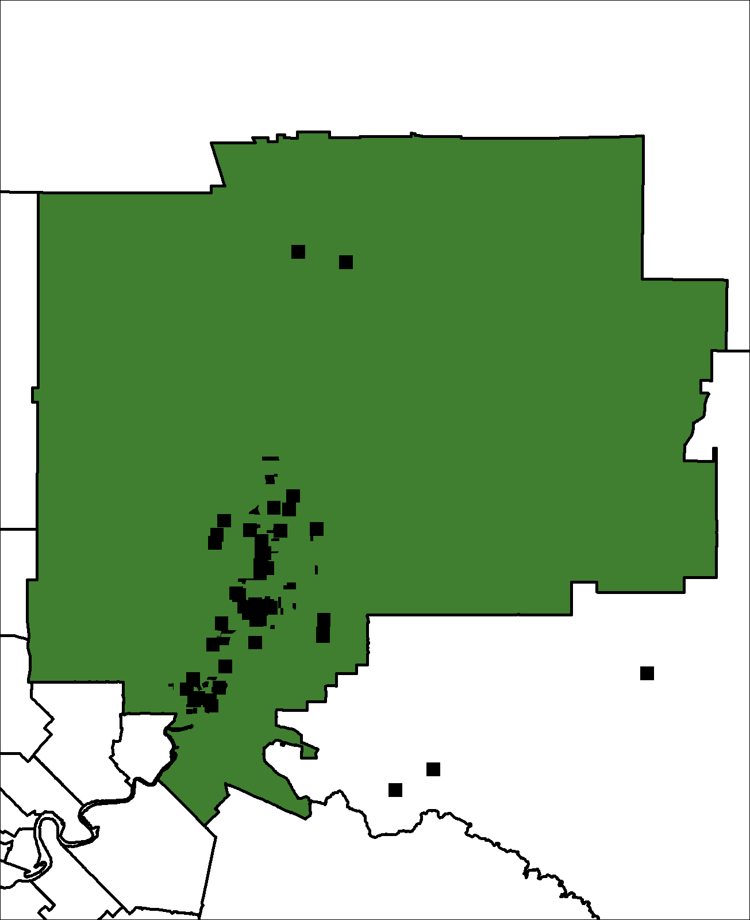
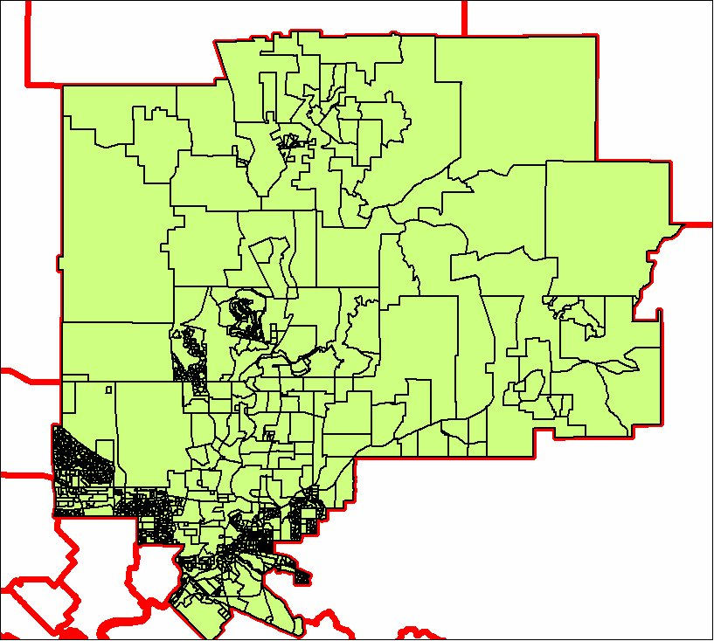
More Accurate Mapping!
Grape Bearing Vines in the SLA of Swan (C)
Notes:
This is the cartographers way of showing things. The actual locations of the vines are visible.
So the location of the boundary is very important in determining the result. We've seen what can happen by changing electoral boundaries - can effect the result of an election
With mesh blocks the statistics can be more accurately mapped

Slide 16
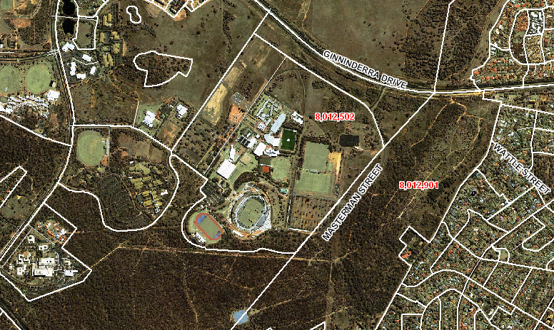
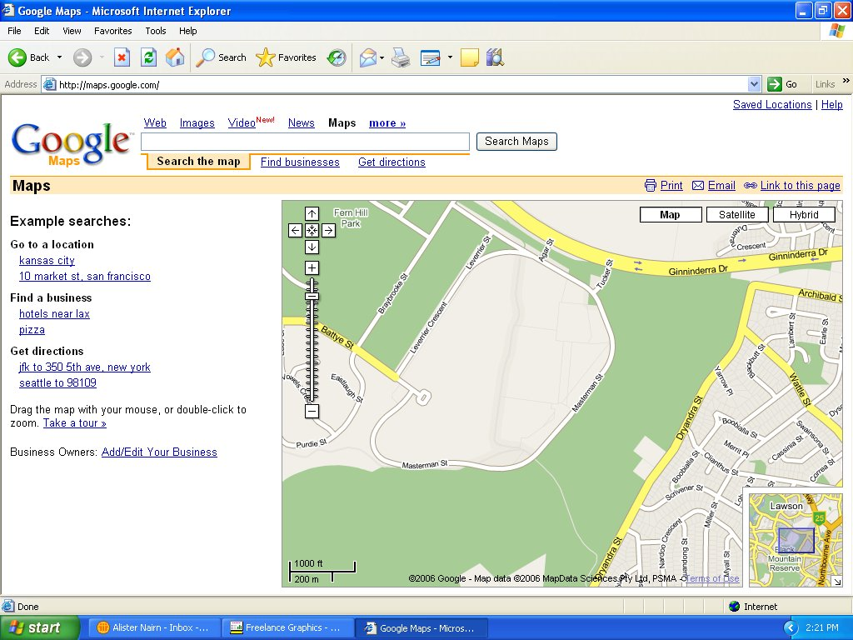
Using Imagery as a Validation Tool
Commercial
Education
Other
Education
Hospital
Residential
Parkland
Parkland
Notes:
This slide shows how MBs look for an area near Belconnen
Note the MB types are:
Water Park Residential
Industrial Commercial Educational
Hospital/medicalAgricultural Other

Slide 17
Notes on Google Imagery
Can add a dimension to maps where high resolution imagery is available
Provided by a web service - saves you managing imagery data
Imagery resolution is high over limited number of cities
Much of the world is only available at 25m resolution (Landsat)
No metadata is provided with the imagery - usually a couple of years old.
NEW - MapInfo now also provide an Imagery Web Service that can be used as a layer within MapInfo

Slide 18
Address Coding - Enabling Small Area Geography
Addresses from surveys etc need to be validated, corrected and geocoded to an appropriate level of geography
Automatic systems including GIS are being used for this process
Geocoded
Geography
Business need eg survey
Parsing &
validatation
Address
Database
Notes:
Address coding is a critical enabling technology when using mesh blocks
If you want to automatically code information based on an address to a mesh block you need to undertake this step.

Slide 19
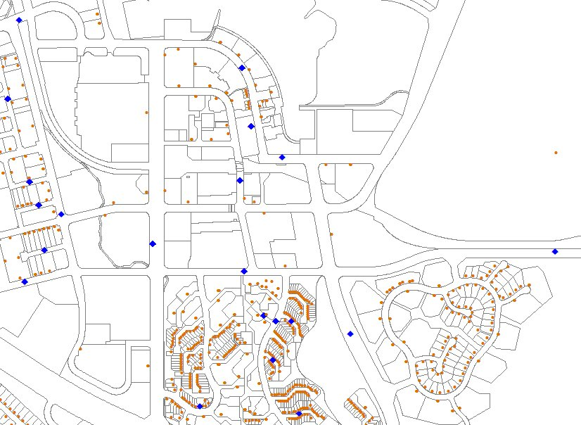
Address Coding - A big issue
ABS Uses a Geocoded National Address File
Accurate locations for 11 million addresses (brown)
1.5 million approximately located to a street or locality (blue)
Rural addresses a problem
Notes:
Mention brown points - geocoded to parcel
Blue points geocoded to street

Slide 20
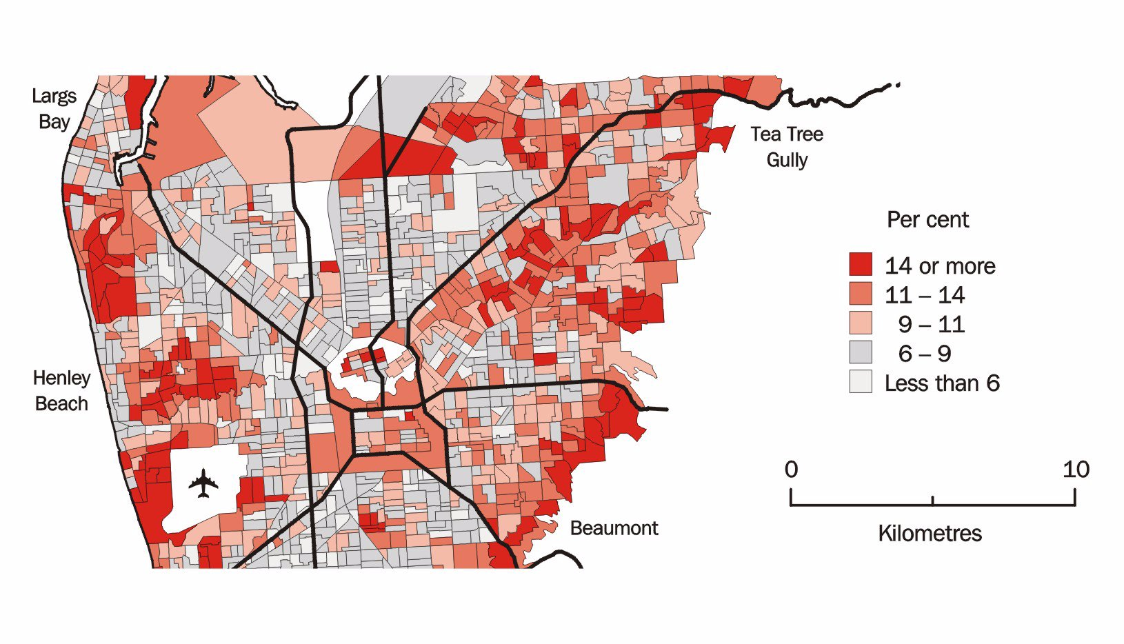
GIS for Analysis and Visualisation of Information
Typical applications such as "show me the areas where criteria 1, .......criteria n are met"
Produced a "Social Atlas" that show population characteristics for major cities - sample for Adelaide below)

Slide 21
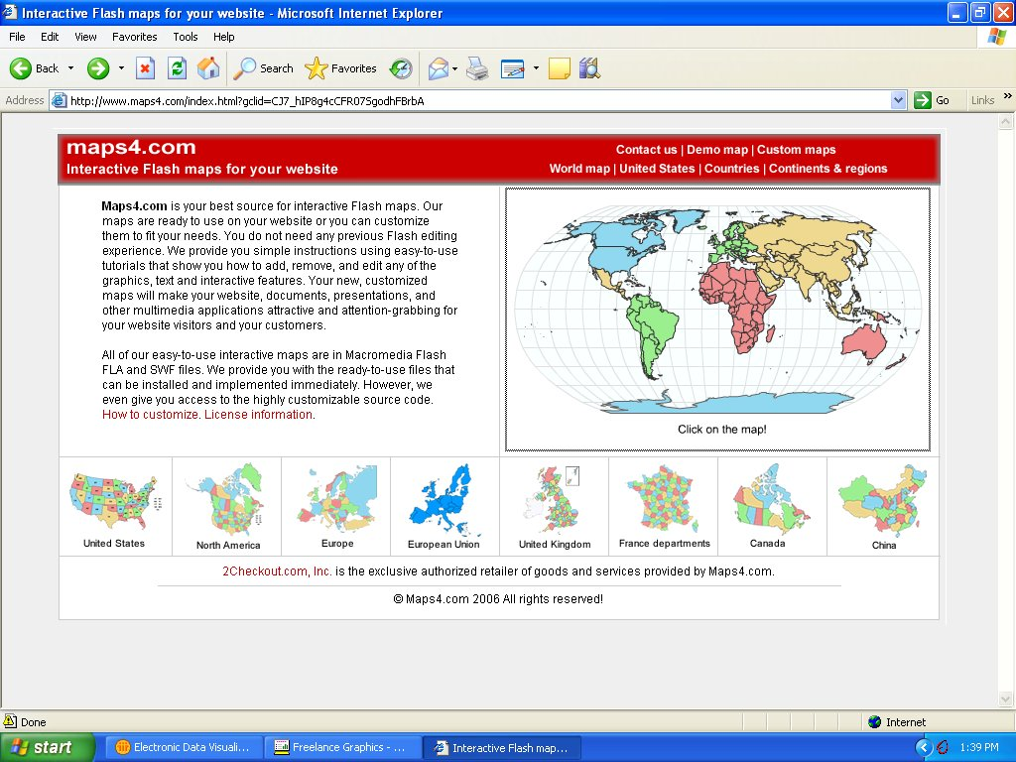
GIS for Analysis and Visualisation of Information
Trend towards smart maps (click on them to display information) or web mapping - maps composed on the fly.

Slide 22
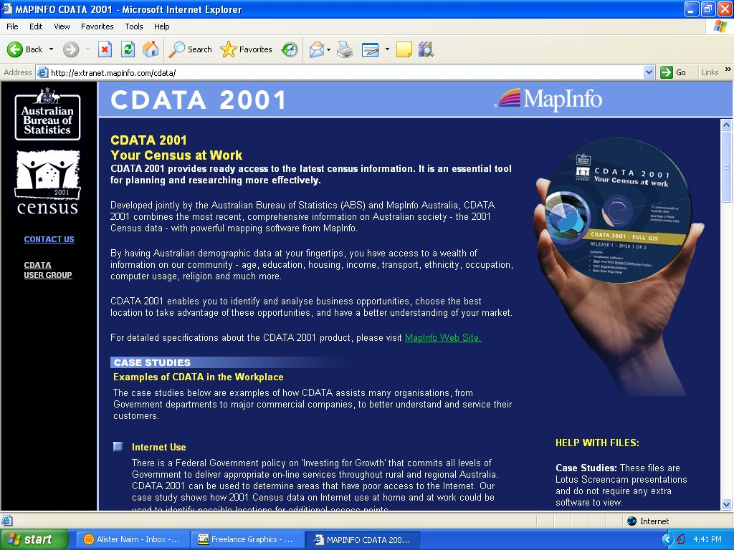
GIS in Dissemination of Statistics
Produced CD based products (CDATA , IRDB) for data dissemination and analysis
Trend now is to provide basic functionality over web interface - Specialist high end services and products provided by partners
Mapping incorporated into Census output system to assist with navigation, selection and visualisation.

Slide 23
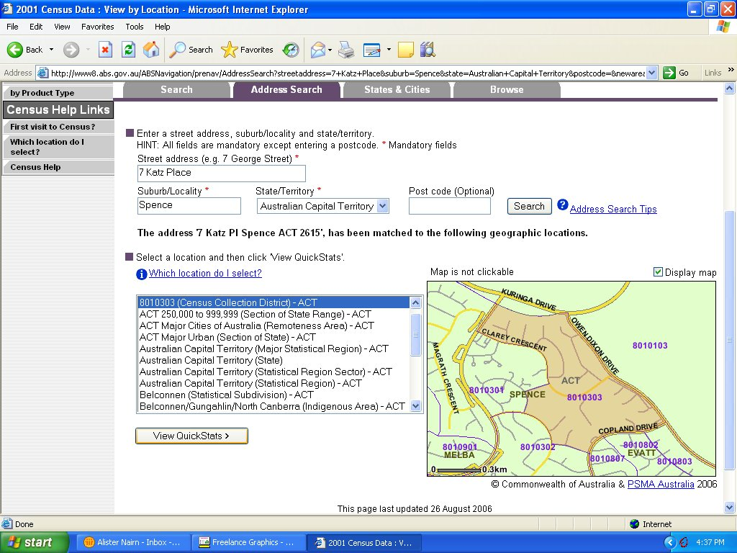
Mapping Used in Census Output System to Confirm Area Selection

Slide 24
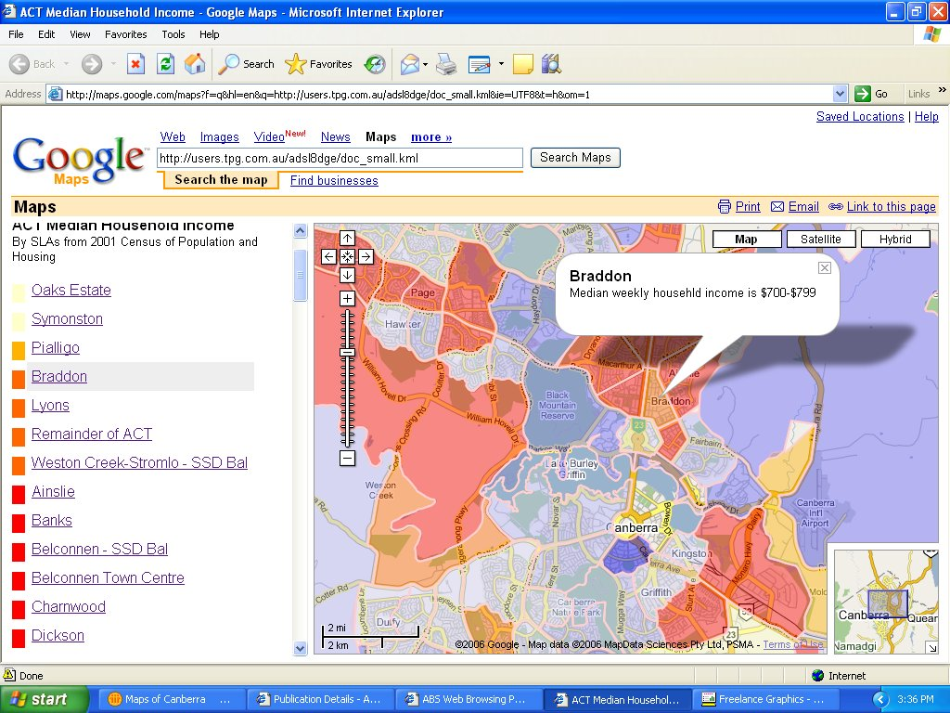
Visualising statistics through Google

Slide 25
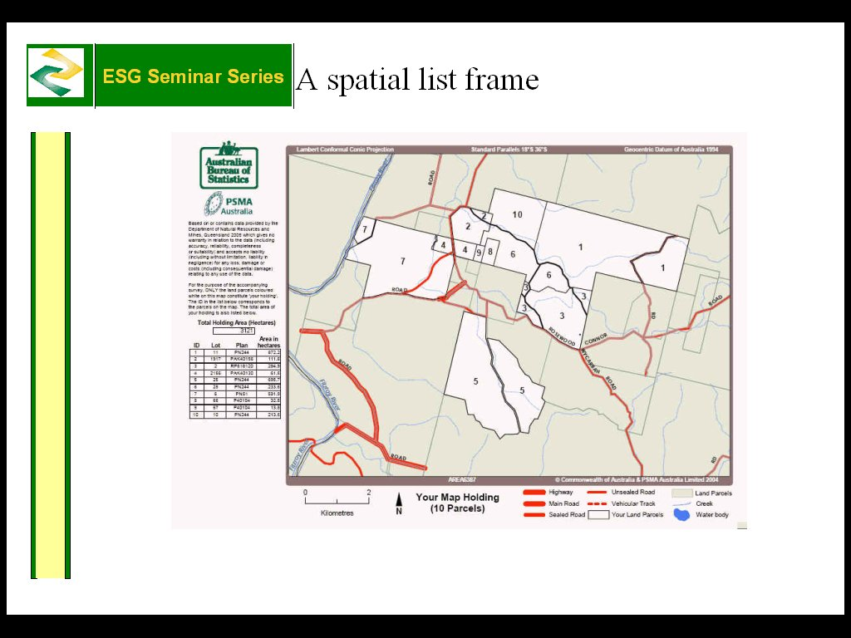
Improving Business Process Using GIS - A land parcel based survey frame

Slide 26
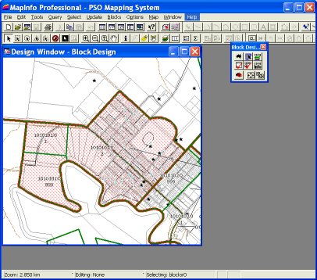
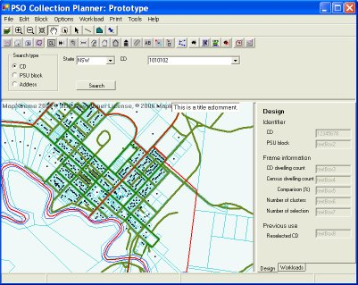
Improving Business Process Using GIS - Population Survey Operations
CD sample selection will be an office based exercise instead of a costly field exercise.
Lists showing the addresses of the selected dwellings and their survey commencement date can be produced.
Better planning and minimising of interviewer costs by locating clusters in small areas.

Slide 27

Future Opportunities
Mobile navigation and data collection

Slide 28
Summary
GIS has been used for amost 20 years within ABS
Access to quality data layers at the required resolution is a prerequisite for success
Initial focus has been on working with partners to develop reliable data supply arrangements
Initial application in production of Statistical geography and mapping and CD based products
Technology such as Google maps can increasingly play a role, together with SVG / Flash for display of "smart maps" online.
Future applications in mobile mapping for data capture and navigation, web disemmination , visualisation and analysis.

